Slide 1
Tube pulse (Harnessing YouTube Insights Using The Cloud)
Introduction to Cloud Computing – CS 5610 Fall 2023
Sai Varun Narajala(700758974)
Prof Dr. Qixiang Pang
The University of Central Missouri.

Slide 2

Content:
Introduction
System Overview
Design Considerations
Architectural Strategies
System Architecture
Detailed System Design
Conclusion

Slide 3

Introduction:
This comprehensive software design documentation outlines the architectural strategies, considerations, and detailed system design for the Tube Pulse project. Tube Pulse is a cloud-based solution that efficiently utilizes Amazon Web Services (AWS) to analyze and extract valuable insights from YouTube data. The primary goals are to ensure scalability, efficiency, and actionable insights for content creators and businesses, ultimately optimizing content strategies. By integrating AWS cloud services, Tube Pulse aims to provide a cost-effective, secure, and scalable solution, unlocking the potential within YouTube's vast dataset.
In the context of Tube Pulse, the document begins by presenting an overview of the entire project, setting the stage for a detailed exploration of system architecture, design considerations, and development methods. The subsequent sections delve into specific components, such as data collection and processing, ensuring a holistic understanding of Tube Pulse's design and functionality.

Slide 4
System Overview
Tube Pulse strategically uses Amazon Web Services to analyze YouTube data, offering a scalable and efficient solution for content creators and businesses. The project recognizes YouTube's significance in the digital landscape and aims to create a robust solution for analyzing its data. The team members, with specific roles assigned, bring diverse expertise to ensure project success. This section establishes the project's context, objectives, and the pivotal role of AWS in achieving scalability, efficiency, and cost-effectiveness.
The collaborative efforts of a diverse team, comprised of data analysts, AWS specialists, software developers, and project managers, ensure the seamless integration and success of Tube Pulse. This strategic approach not only addresses current user needs but also positions the project for future growth, emphasizing adaptability, integration potential, and an unwavering commitment to continuous improvement in response to the evolving digital landscape.

Slide 5
Design Considerations
Assumptions and DependenciesTube Pulse assumes the availability and reliability of YouTube APIs for real-time data collection and depends on seamless integration with AWS services. These assumptions guide design decisions, emphasizing the need for robust connections between Tube Pulse and external platforms.
Goals and GuidelinesTube Pulse aims to build a scalable, cost-effective cloud-based system, achieve 90% accuracy in sentiment analysis, and predict video trends with the same accuracy. The chosen development method is the AWS Python ETL Pipeline project, providing a structured approach to data extraction, transformation, and loading.
Development MethodsThe selected development method, the AWS Python ETL Pipeline project, utilizes SQL and Python3 for efficient data processing, aligning with industry best practices.

Slide 6
Architectural Strategies
Strategy 1: The first architectural strategy involves leveraging AWS services such as S3, Lambda, and QuickSight. This ensures efficient data processing, storage, and visualization, contributing to Tube Pulse's overall success.
Strategy 2: The second architectural strategy focuses on AWS Glue, Athena, and IAM for robust data integration, search capabilities, and access controls to safeguard Tube Pulse's data.

Slide 7
System Architecture
Component 1: Data CollectionComponent 1 involves real-time data collection from YouTube APIs, ensuring Tube Pulse stays updated with the latest YouTube data.
Component 2: Data Processing and AnalysisComponent 2 focuses on efficient processing and in-depth analysis of video statistics, comments, and user engagement to extract actionable insights.

Slide 8
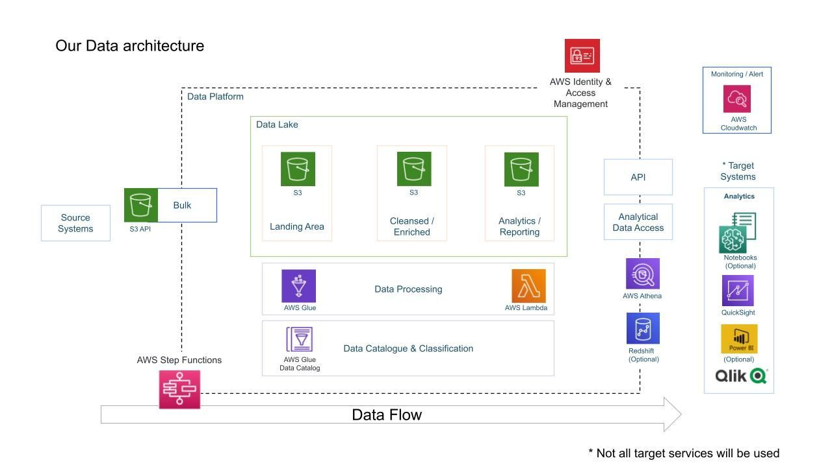

Slide 9
System Design
Module 1: AWS Python ETL Pipeline
1.1 Data SourceTube Pulse utilizes a Kaggle dataset containing daily popular YouTube video statistics (CSV files) as its primary data source.
1.2 Data PreparationThe data preparation phase involves handling missing values, cleaning, and transforming data types using Python scripts.
2 Setting Up The Environment For Building A Python Data Pipeline
2.1 AWS Account SetupTube Pulse guides users through creating an AWS S3 account, configuring an IAM user/admin, and installing the AWS CLI.
2.2 AWS CLI InstallationInstallation and configuration of the AWS CLI are essential for effective communication between Tube Pulse and AWS services.
2.3 Data LoadingData loading involves using the AWS CLI to transfer Kaggle YouTube video dataset files into an AWS S3 bucket.

Slide 10
3 Creating An AWS S3 Bucket For The ETL Pipeline
3.1 Best PracticesTube Pulse emphasizes best practices for creating an S3 bucket, considering naming conventions, versioning, and access controls.
3.2 AWS Glue CatalogCreating the AWS Glue Catalog is critical for easy data discovery and cataloging, streamlining data management.
4 Creating AWS Glue Catalog For The AWS ETL Pipeline
4.1 Crawlers and ETLTube Pulse employs AWS Glue Crawlers to automatically discover and catalog data from the S3 bucket, integrating ETL processes for data transformation.
4.2 Data CatalogingData cataloging in AWS Glue enhances data organization and accessibility for users to query and analyze information.
5 AWS Lambda Data Pipeline
5.1 Lambda Function CreationTube Pulse provides a guide on creating a Lambda function for data extraction, considering event and context parameters.

Slide 11
5.2 Data Wrangler IntegrationIntegration of AWS Data Wrangler within the Lambda function ensures efficient data manipulation, optimizing the ETL pipeline.
5.3 Data MaterializationMaterializing data into Parquet format in a new S3 bucket is crucial for optimizing data organization and cataloging.
6 Data Processing Using AWS Glue Studio
6.1 Spark ETL JobsTube Pulse guides the creation of Spark ETL jobs within AWS Glue for transforming JSON data to Parquet format.
6.2 Automating Data DiscoveryAutomating data discovery with an S3 crawler streamlines the process, optimizing data extraction and cataloging.
7 Data Visualization Using AWS QuickSight
7.1 ETL Workflow AutomationTube Pulse guides users in creating and triggering ETL workflows in Glue Studio, automating the transformation of raw JSON data to Parquet format.

Slide 12
7.2 QuickSight Dataset CreationCreating datasets in QuickSight using Athena's analytics database prepares the foundation for data visualization.
7.3 Dashboard CreationThe final step involves creating dashboards in QuickSight, allowing users to customize and generate insightful visualizations.

Slide 13
Conclusion
In conclusion, this comprehensive document provides an overview of Tube Pulse's software design, covering data exploration, environment setup, ETL pipeline creation, and data visualization. Tube Pulse's structured design ensures efficient YouTube data analysis and actionable insights for content creators and businesses. The document serves as a guide, offering detailed insights into each module and component of Tube Pulse's software design, ensuring originality and adherence to best practices.

